Slide 1
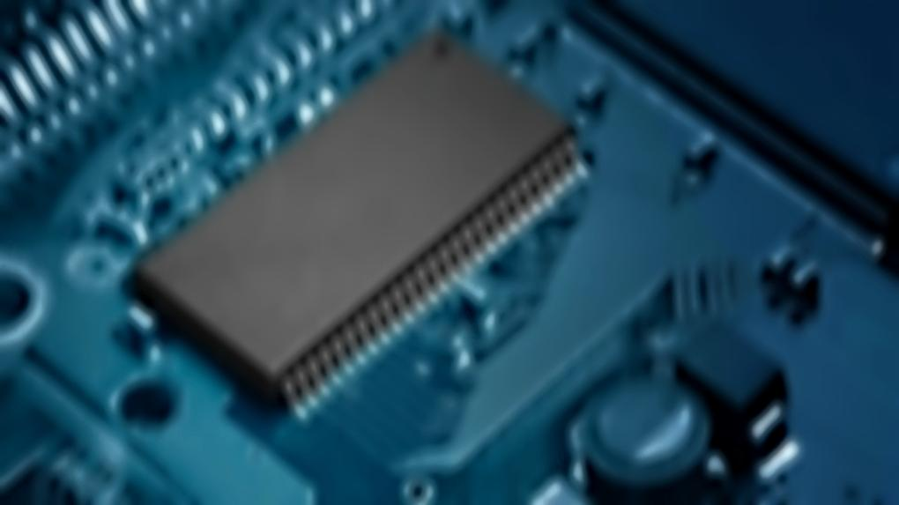
EC881 : PROJECT STAGE-2
LCD AND HEX KEYPAD INTERFACED 8051 BASED 2-DIGIT CALCULATOR USING ASSEMBLY LANGUAGE PROGRAMMING

Slide 2

PRESENTED BY :-
SHOUVIK GHOSH #34900318031
SHIRSHENDU DAS #34900318033
SAYANDEEP MAHATA #34900318038
DIBENDU MONDAL #34900318063
AYUSH PODDAR #34900318068
Department of Electronics & Communication, Cooch Behar Government Engineering College

Slide 3
UNDER THE SUPERVISION OF:-
Dr. Palash Das
Assistant Professor,
Dept. of Electronics and
Communication
COOCHBEHAR GOVERNMENT
ENGINEERING COLLEGE
Department of Electronics & Communication, Cooch Behar Government Engineering College

Slide 4
OBJECTIVE:
In this project, individuals will demonstrate a 2 digit calculator based on 8051 assembly program interfaced with LCD and Hex-Keypad on Edsim51 simulator. Through this project students will get familiarized of different codes of assembly program, working module of the simulator as well as different aspects of the 8051 microcontroller and the HD44780U LCD.
Department of Electronics & Communication, Cooch Behar Government Engineering College

Slide 5
INTRODUCTION:
In this project, Edsim51 is being used as a simulator which is available with a Hitachi HD44780U LCD Module AND A 4X3 MATRIX KEYPAD. WE BEGIN WITH INTERFACING THE LCD MODULE AND 4X3 keypad present in EDSIM51, and then we simulate the program of a 2 digit calculator performing basic calculations like addition, subtraction, multiplication and division.
Department of Electronics & Communication, Cooch Behar Government Engineering College

Slide 6
COMPONENTS USED:
8051 MCU – AT89C52
Hitachi HD44780U LCD MODULE
Edsim51 Simulator
3X4 Keypad
Department of Electronics & Communication, Cooch Behar Government Engineering College

Slide 7
8051 Microcontroller
It was created by Intel in 1981. It is an 8-bit microcontroller. It is built with 40 pins DIP(Dual Inline Package), 4kb of ROM storage, 128 bytes of RAM storage, 2 16-bit timers. It consists of 4 parallel 8-bit ports which are programmable as well as addressable as per the requirement. An on-chip crystal oscillator is integrated in microcontroller having crystal frequency of 12 Mhz.
Department of Electronics & Communication, Cooch Behar Government Engineering College

Slide 8
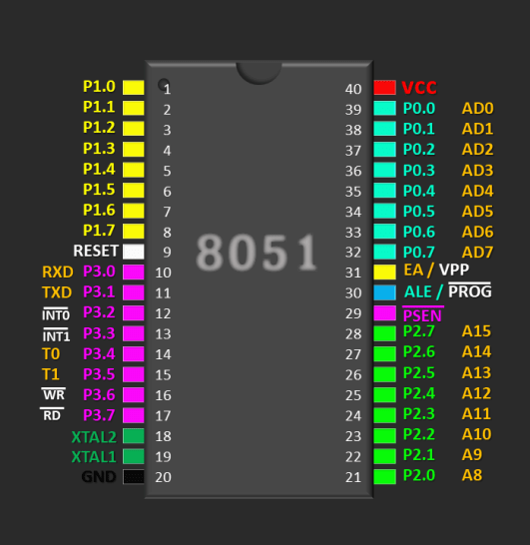
8051 - PIN DIAGRAM

Slide 9
Edsim51 Simulator
Edsim51 simulator is used by professional 8051-based embedded system designers. While they show the state of registers, memory and port pins, while code is being debugged, it has graphical representation of peripherals that can be used interactively to communicate with the 8051.
Department of Electronics & Communication, Cooch Behar Government Engineering College

Slide 10
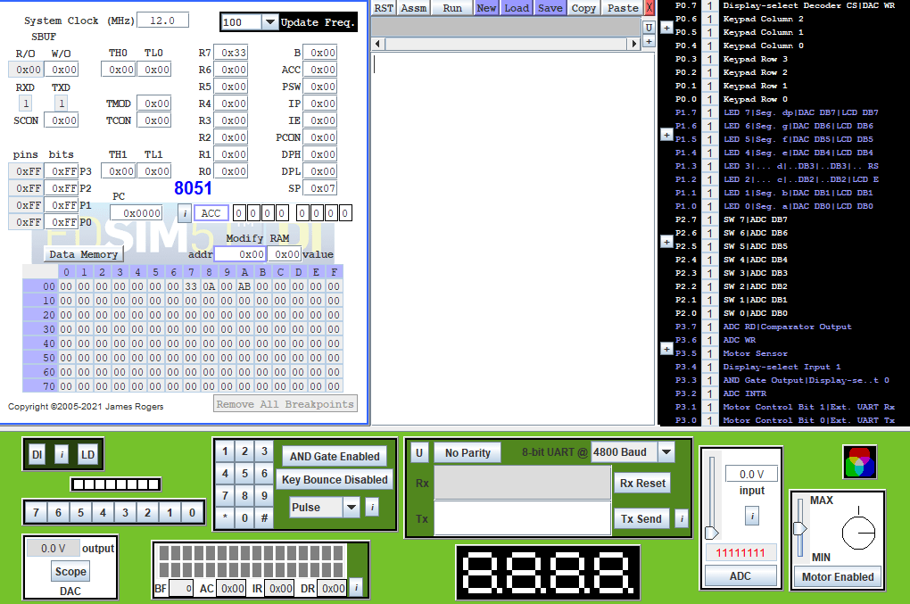
Edsim51 - simulator

Slide 11
Matrix keypad
A MATRIX KEYBOARD IS A COMMONLY USED INPUT DEVICE WHEN MORE THAN EIGHT KEYS ARE NECESSARY. A MATRIX KEYBOARD REDUCES THE NUMBER OF CONNECTIONS. FOR EXAMPLE, A KEYBOARD WITH 12 KEYS, CAN BE ARRANGED IN A 4X3(FOUR ROWS AND THREE COLUMNS) MATRIX.
Department of Electronics & Communication, Cooch Behar Government Engineering College

Slide 12
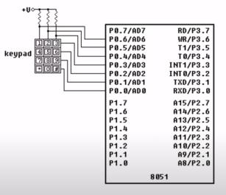
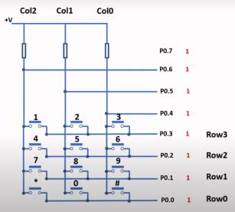
KEYPAD WORKING
IN EDSIM, THE KEYPAD USES THE PORT 0 OF THE 8051 MICROCONTROLLER OUT OF WHICH PIN P0.0 TO P0.6 IS BEING USED AND P0.7 IS LEFT UNUSED. PIN P0.0 - PIN P0.3 ARE CONNECTED TO ROW0, ROW1, ROW2, ROW3 RESPECTIVELY & P0.4 – P0.6 ARE CONNECTED TO COL0, COL1, COL2 RESPECTIVELY.
INITIALLY ALL PINS FROM P0.0 TO PIN 0.6 ARE SET HIGH (LOGIC 1). WHEN SCANNING THE ROW0, PIN P0.0 IS MADE LOW (LOGIC 0), AND LETS ASSUME THAT KEY # IS PRESSED. SO ON PRESSING #, IT WILL SHORT THE ROW0 AND COL0 AND SIMULTANEOUSLY PIN P0.4 WILL AUTOMATICALLY GO LOW. HENCE THE MICROCONTROLLED WILL DETECT THAT P0.4 IS LOW i.e. THE KEY PRESSED IS #.

Slide 13
Hitachi HD44780U LCD MODULE
The Hitachi HD44780U LCD controller is an alphanumeric dot matrix liquid crystal display(LCD) controller developed by Hitachi in 1980s. The character set of the controller includes ASCII characters, Kana characters, and some symbols in two 28 character lines.
Department of Electronics & Communication, Cooch Behar Government Engineering College

Slide 14
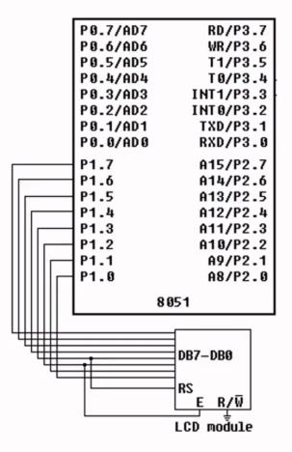
4-bit Mode: The LCD module is a simulation of the Hitachi HD44780 and is interfaced to the 8051 in 4-bit mode. P1.7 through P1.4 are connected to DB7 through DB4, while P1.3 is connected to the register-select pin and P1.2 is connected to the enable pin. Notice the read-write pin is connected to ground - the module can only be written to.
8-bit Mode: By default, as stated above, the module is interfaced in 4-bit mode. However, the lower four data bits (DB3 through DB0) are also available (on P1.3 through P1.0). If the user wishes to write to the module in 8-bit mode, RS and E should be remapped to other port pins.

Slide 15
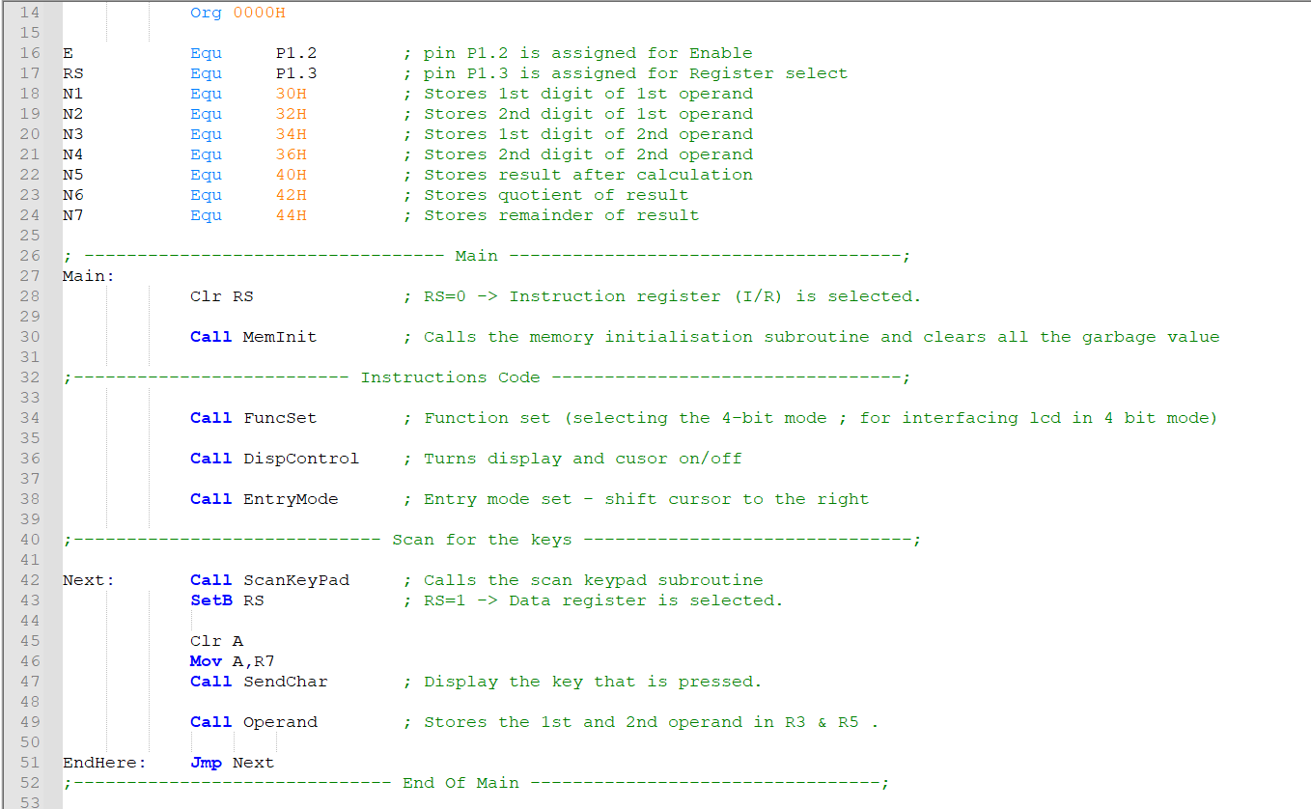
PROGRAM
MAIN FUNCTION

Slide 16
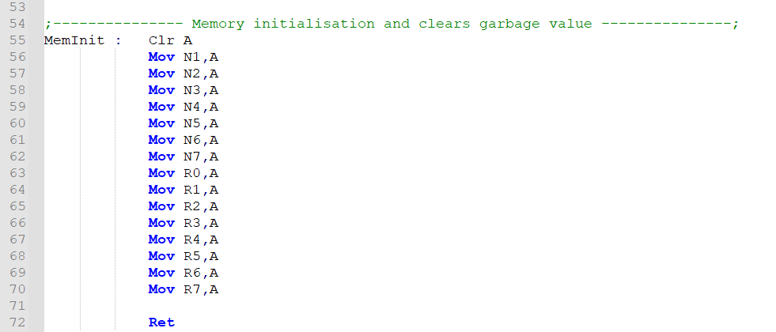
MEMORY Initialisation

Slide 17
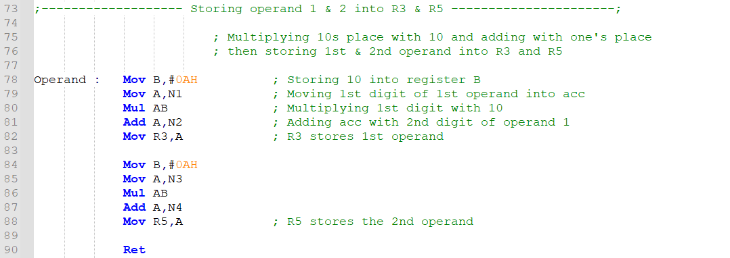
STORING OPERANDS

Slide 18
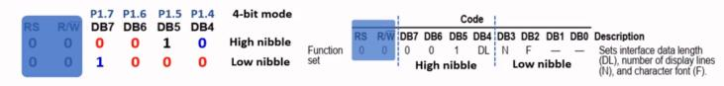
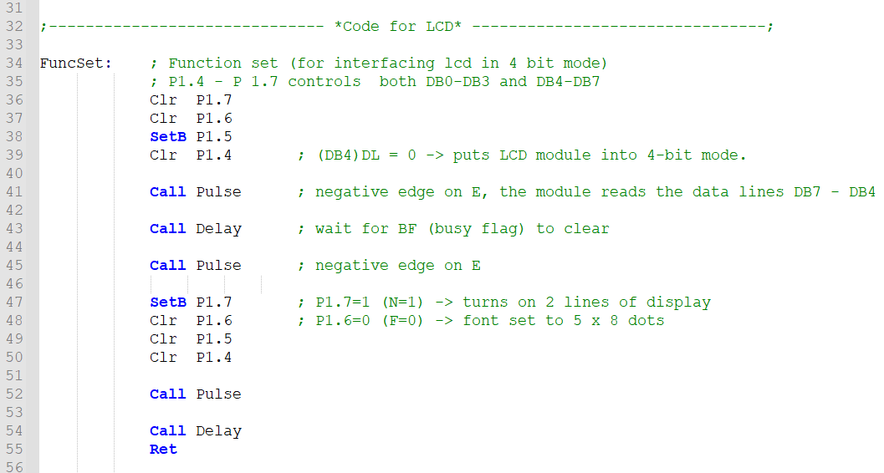
INTERFACING THE LCD WITH MCU

Slide 19
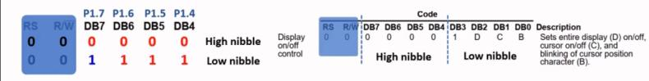
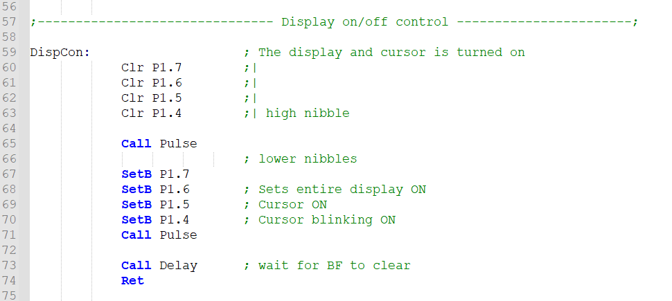
SUBROUTINE FOR TURNING DISPLAY ON/OFF, CURSOR BLINKING

Slide 20
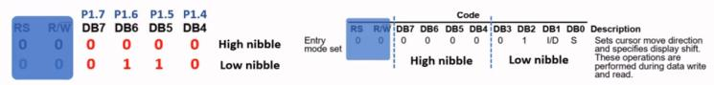
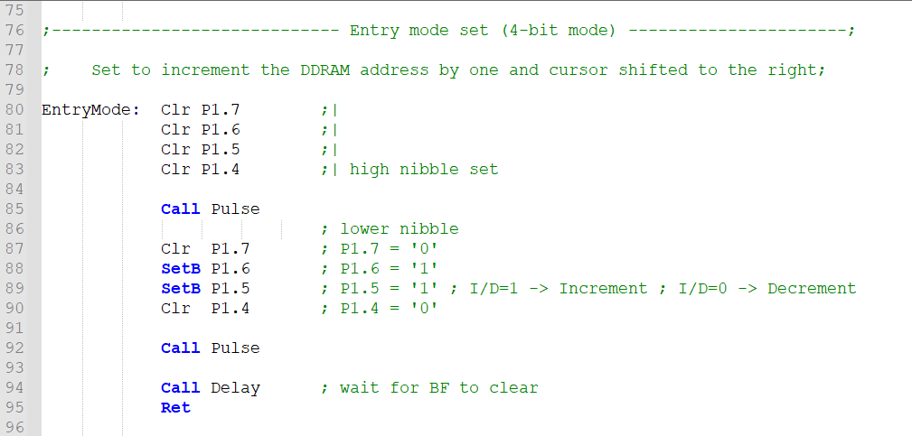
INCREMENT OF DDRAM AND SHIFTS THE CURSOR

Slide 21
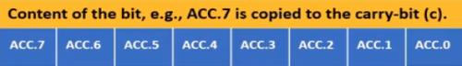
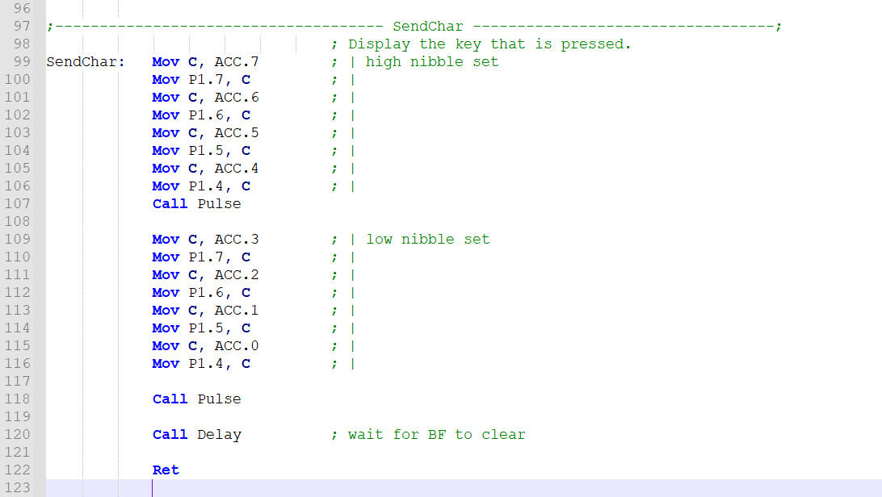
DISPLAYING THE KEY THAT WAS PRESSED

Slide 22
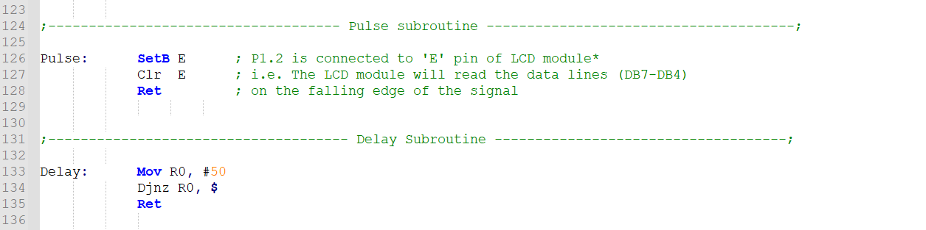
PULSE AND DELAY SUBROUTINES

Slide 23
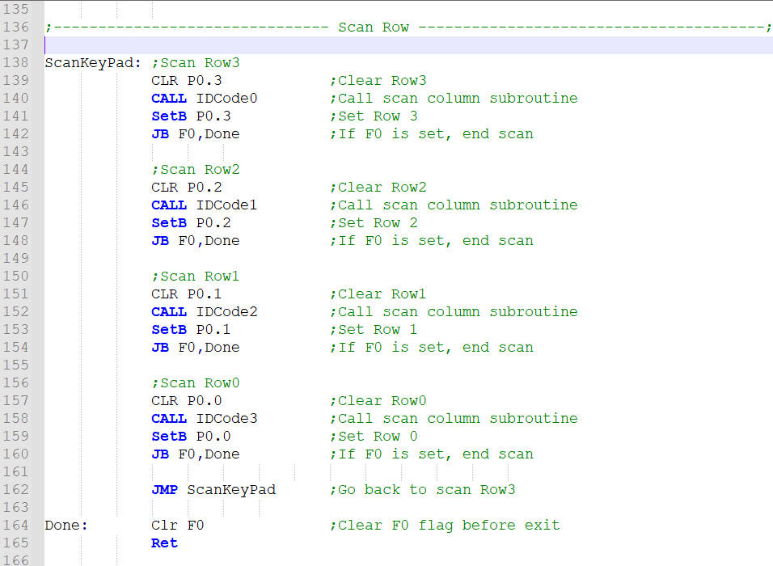
INTERFACING OF KEYPAD WITH MCU - SCANNING ROWS

Slide 24
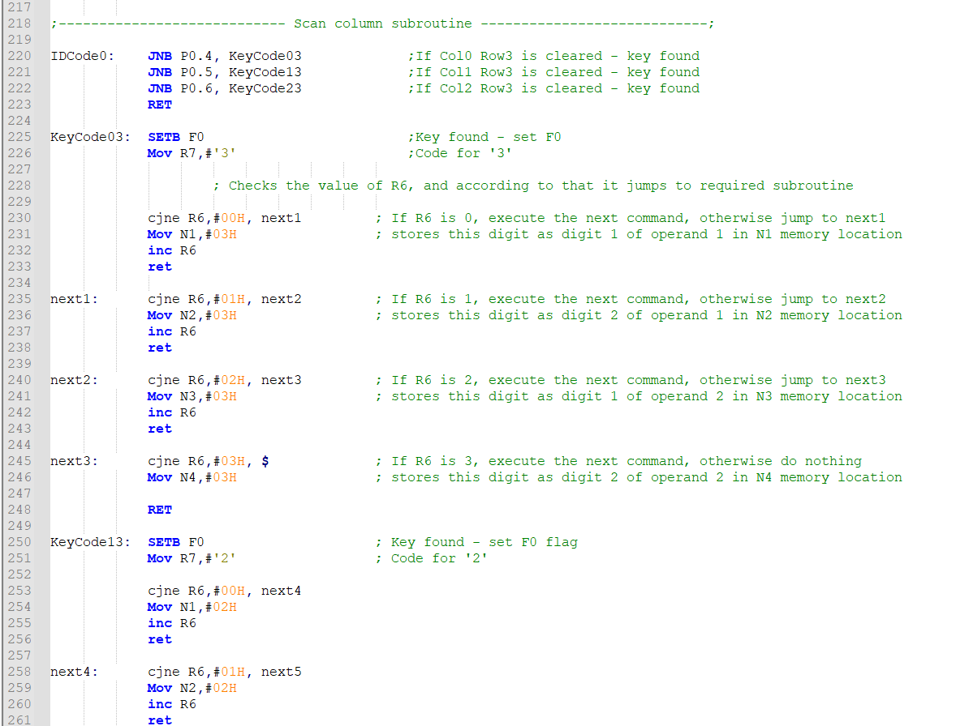
SCANNING COLUMN

Slide 25
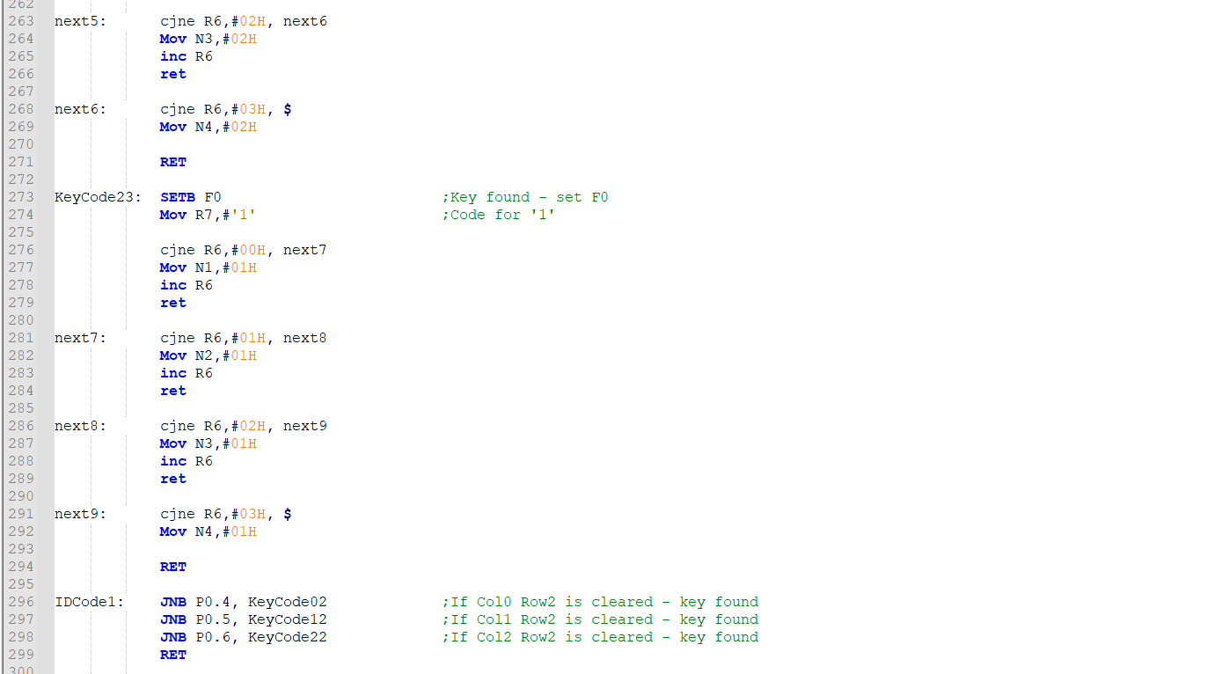

Slide 26
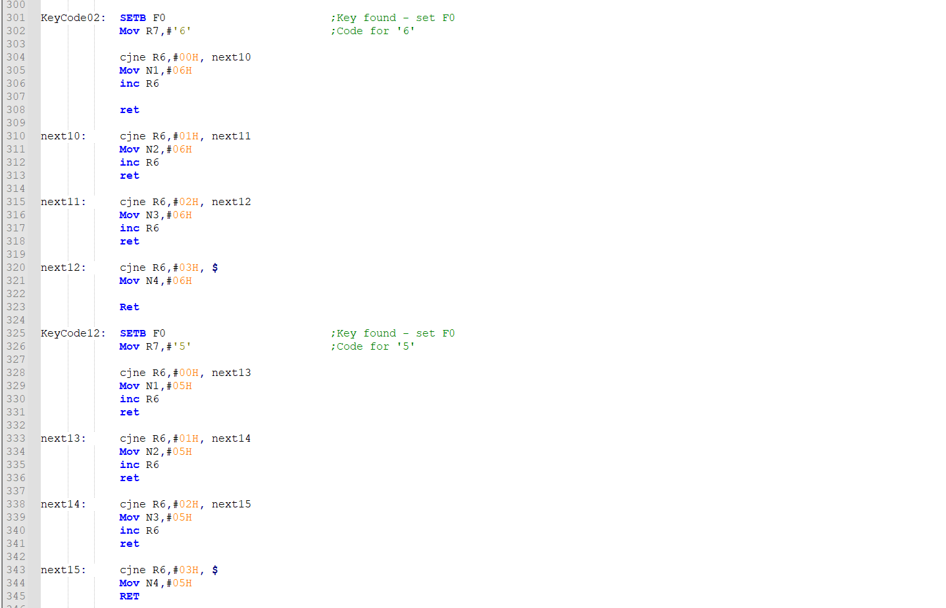

Slide 27
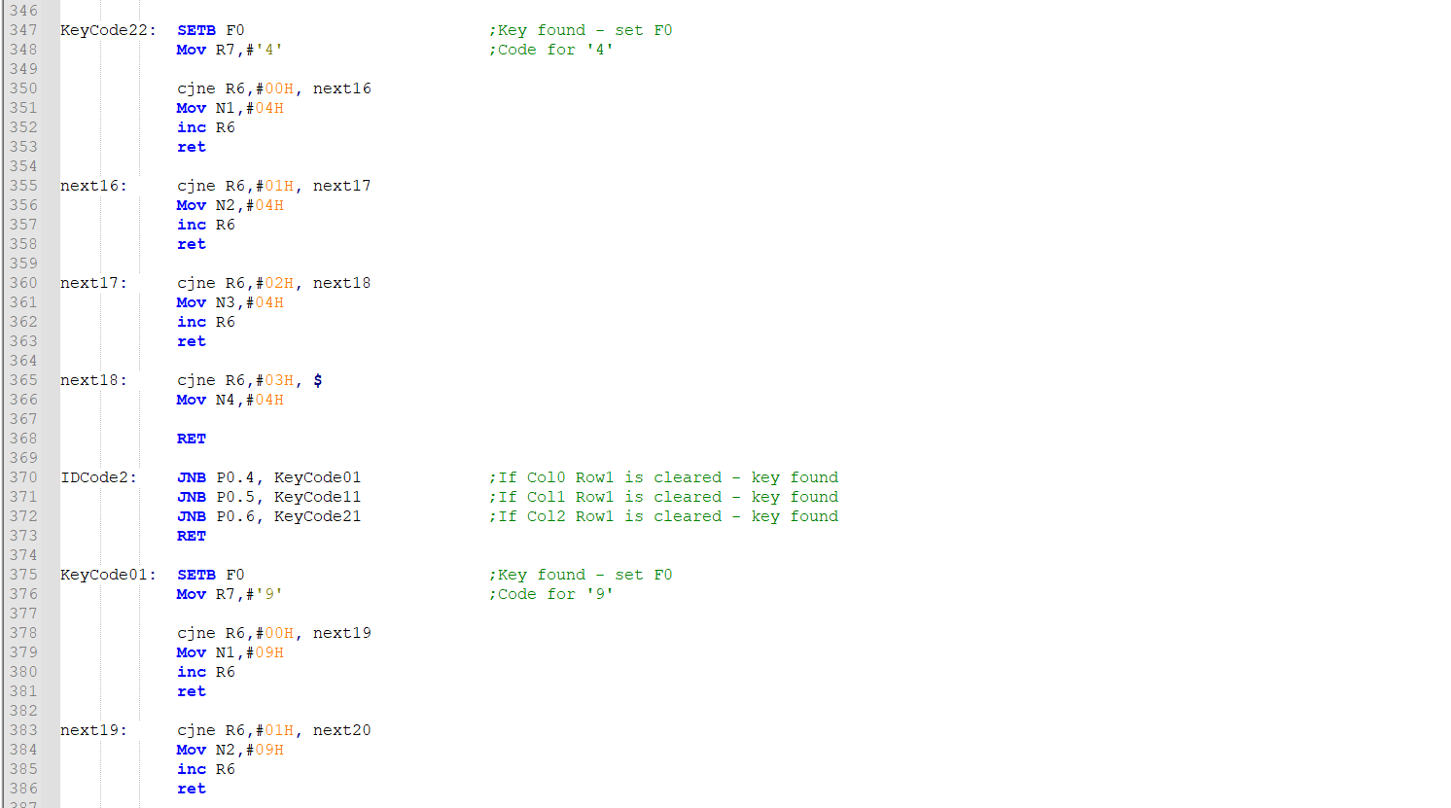

Slide 28
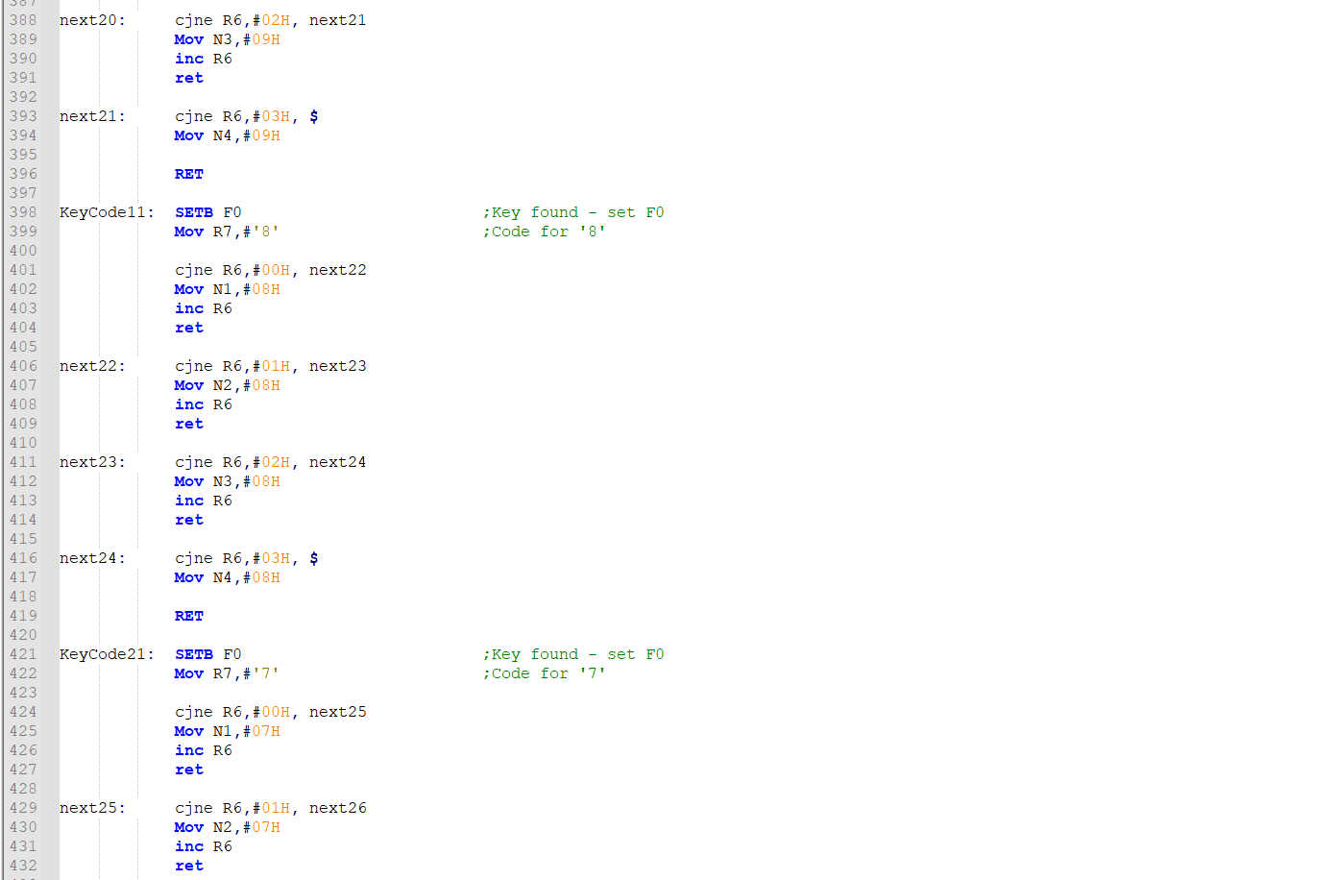

Slide 29
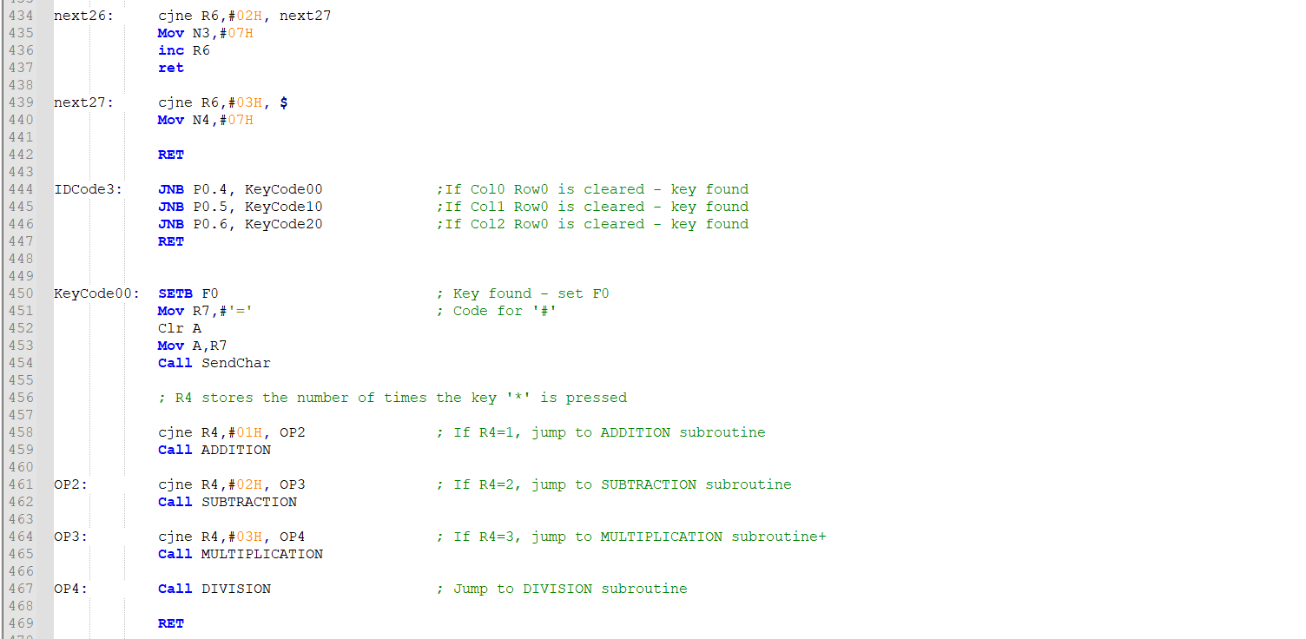

Slide 30
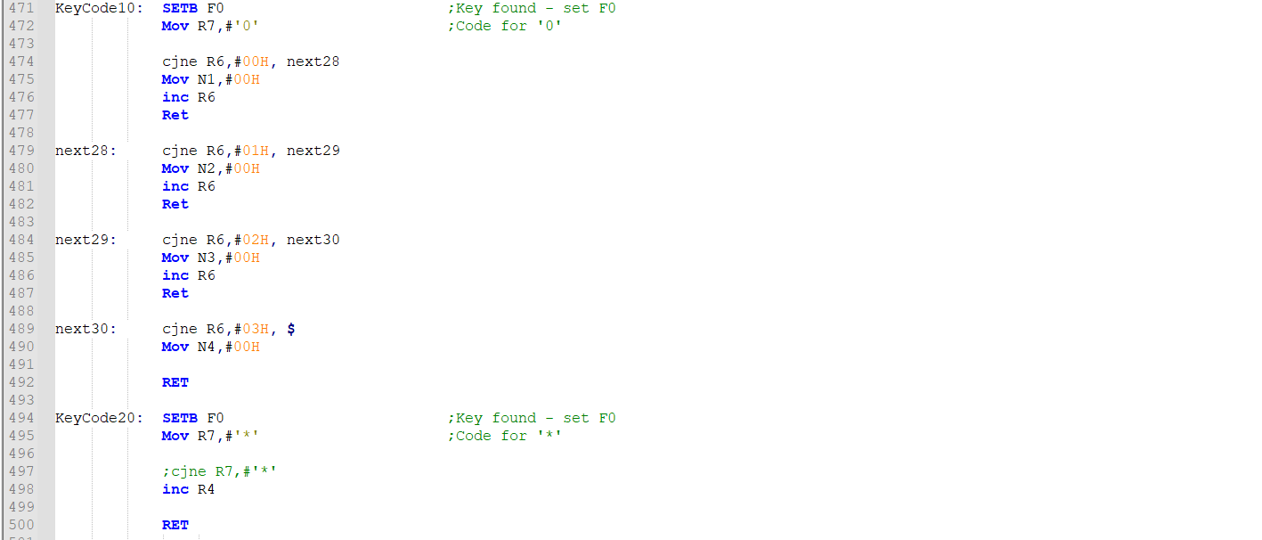

Slide 31
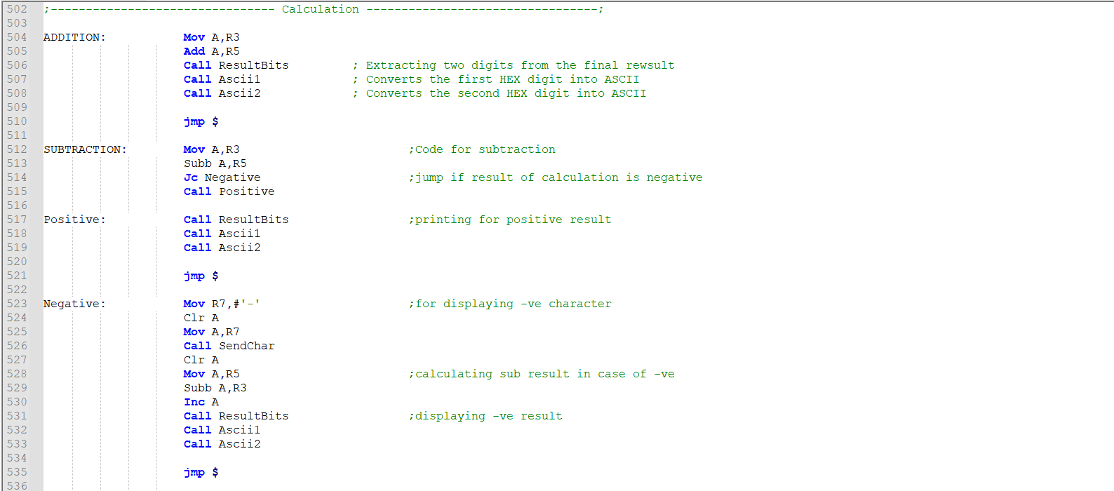
CODE FOR CALCULATION

Slide 32
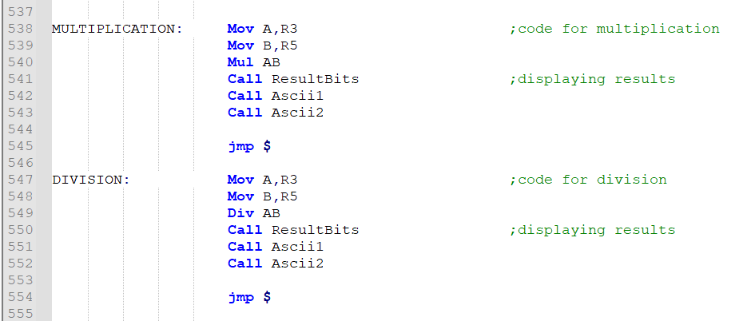

Slide 33
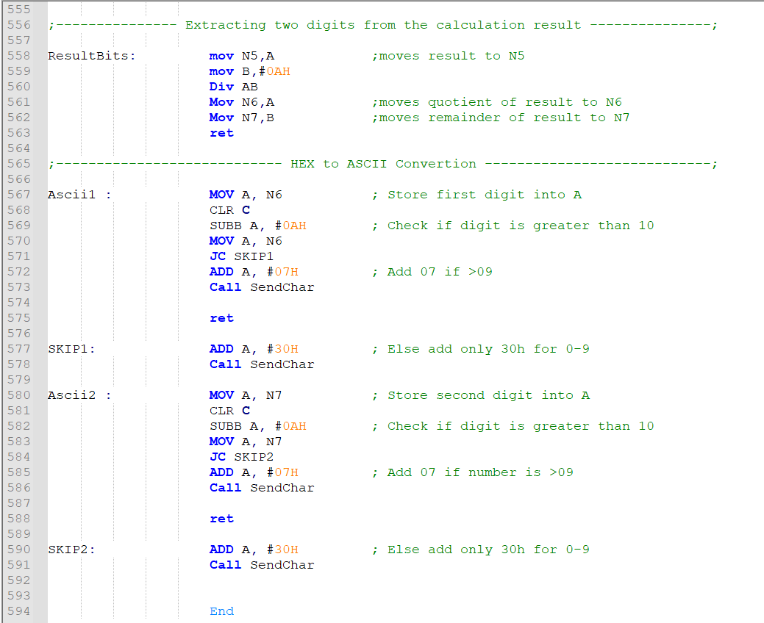
CODE FOR showing result

Slide 34
ACKNOWLEDGEMENT
It is our pleasure to acknowledge our supervisor Dr. Palash Das, Assistant Professor, Department of Electronics and Communication Engineering, Cooch Behar Government Engineering College, for assigning us to this wonderful project. The information and encouragement received from him has been very helpful. Lastly, we would like to express our gratitude to all the researchers and authors of various academic resources whose references have been useful for achieving the end goal of this project.

Slide 35
REFERENCES AND BIBLIOGRAPHY
Microprocessor architecture, Programming, and Applications - Ramesh Gaonkar
The 8051 Microcontroller - AYALA
https://www.edsim51.com/examples.html#prog4_b
https://www.edsim51.com/examples/lcd.asm
https://www.edsim51.com/simInstructions.html#lcdModule

